Slide 1
Tips on Group Project

Slide 2
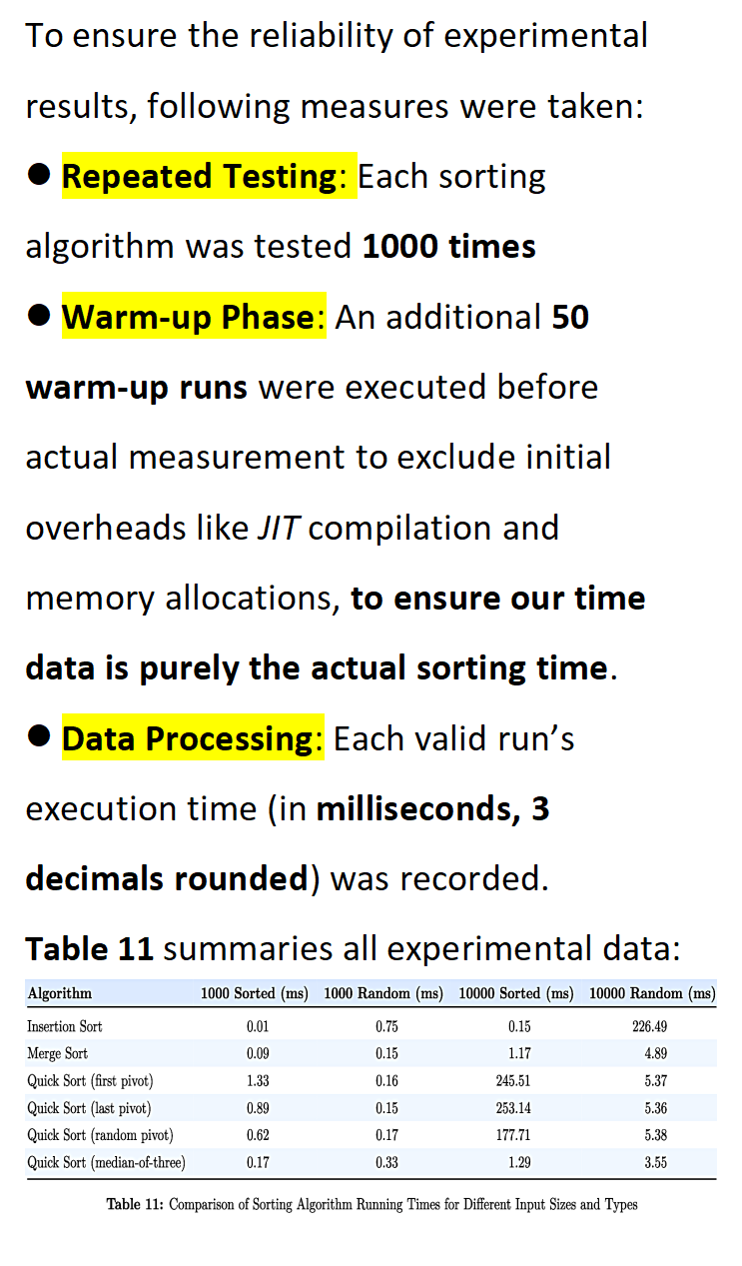
Make the reported data explainable
A typical case is the Required Output (the table) in Task A
Better to tell us how you get the times in the table
Repeated Testing for the average
Warm-up tests to reduce the measurement noises (Java programs may run more slowly at the beginning due to JVM initialization, class loading, ect)
Rounding for readability (2 decimals , 3 decimals, etc)

Slide 3
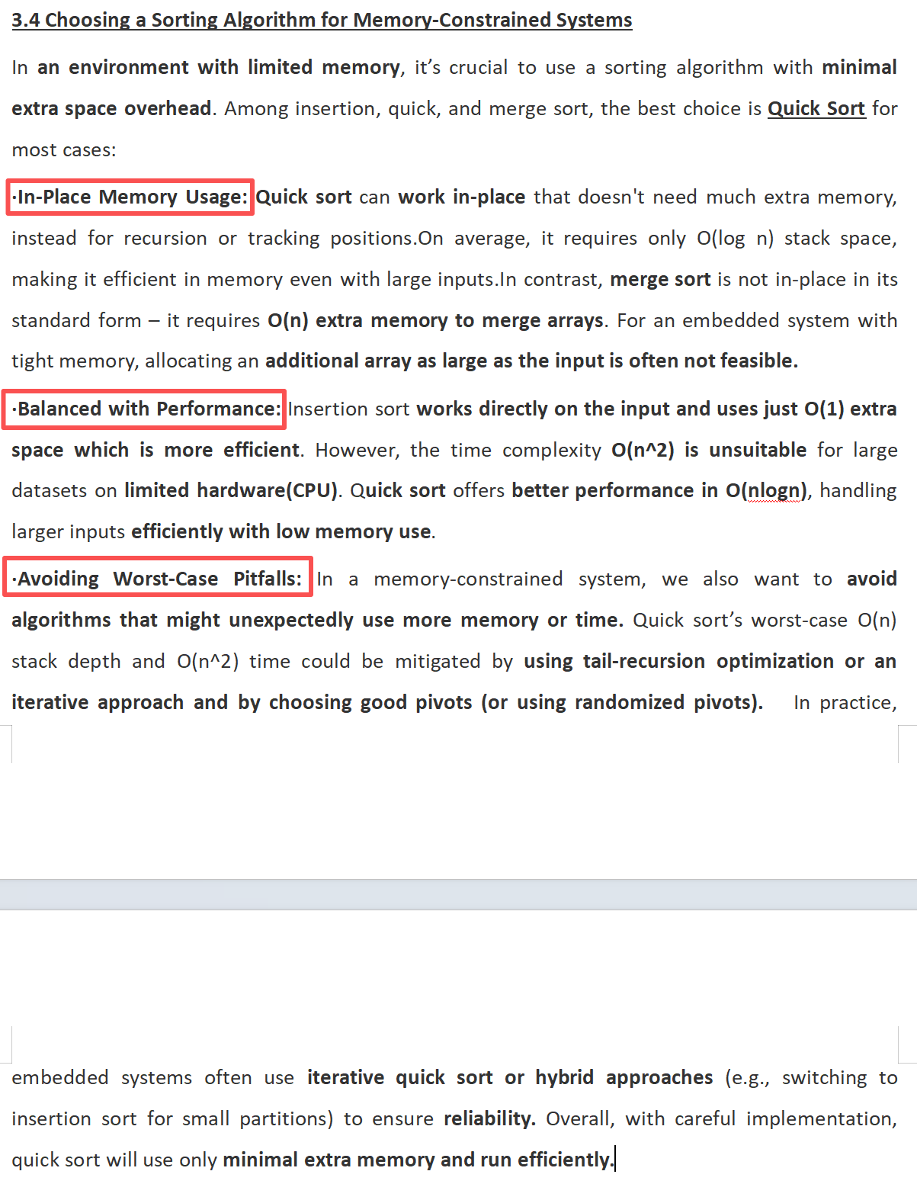
Pay attention to the follow-ups
In the task sheet, we have many follow-up questions, for examples:
What alternative graph algorithms could be considered if the graph were unweighted? How might they compare with your current choice?
Which sorting algorithm behaves most consistently across the three datasets? Why?
If you were allowed to use only one sorting algorithm in the final system, would you choose the one with the best average runtime, the most stable behaviour, or the simplest implementation? Why?
The follow-ups are actually the main part of the such questions.

Slide 4
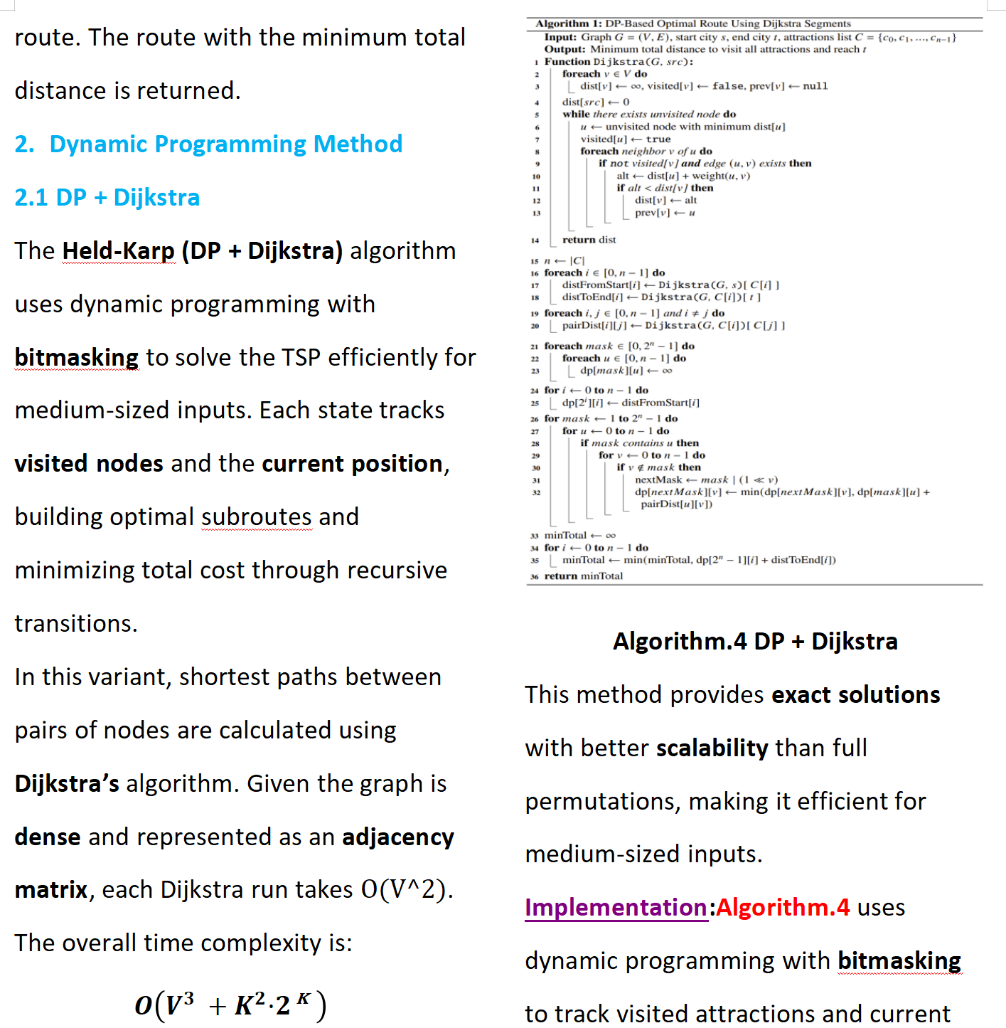
Exploratory questions
In the task sheet, we have some questions regarding the assumptive conditions, for example:
If both runtime efficiency and memory usage are considered, how would your algorithm choice be affected?
What alternative graph algorithms or route-planning approaches might become more suitable if the graph became much larger, or if node coordinates were available? Discuss their possible advantages and limitations.
This is where we need to do some self-studies (e.g., the space complexity). For the alternative graph algorithms, implementation is NOT necessary.

Slide 5
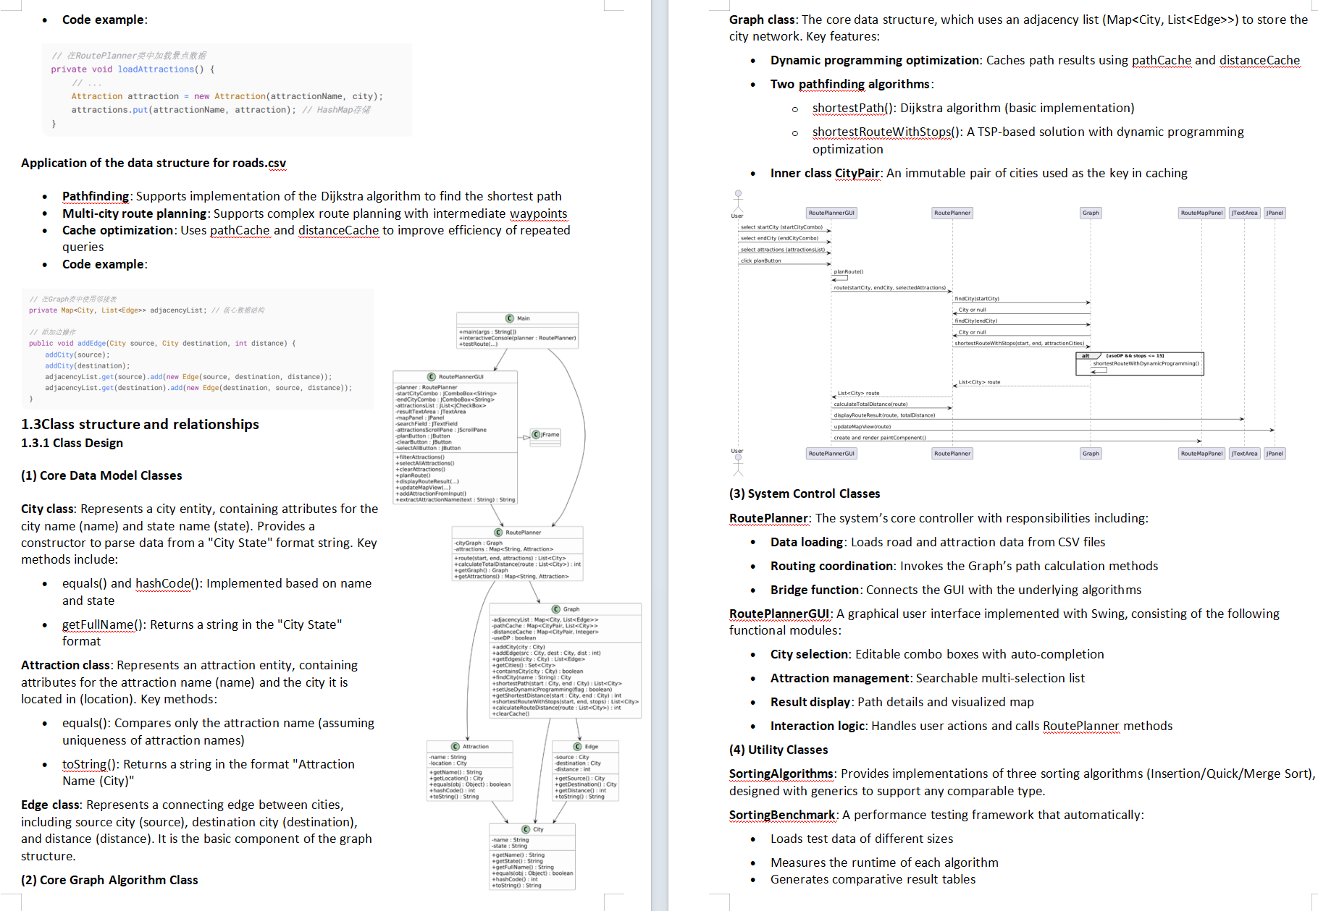
Screenshots and UMLs help
Especially in Task C, we require you to illustrate the design of the program with questions like:
What classes did you use in your application?
How do these classes and functions collaborate to complete the whole inspection workflow?
How are these principles applied specifically? For example, how did you use polymorphism to support different behaviours through a common interface or abstraction?
Code screenshots and UML can really help us understand your design.

Slide 6
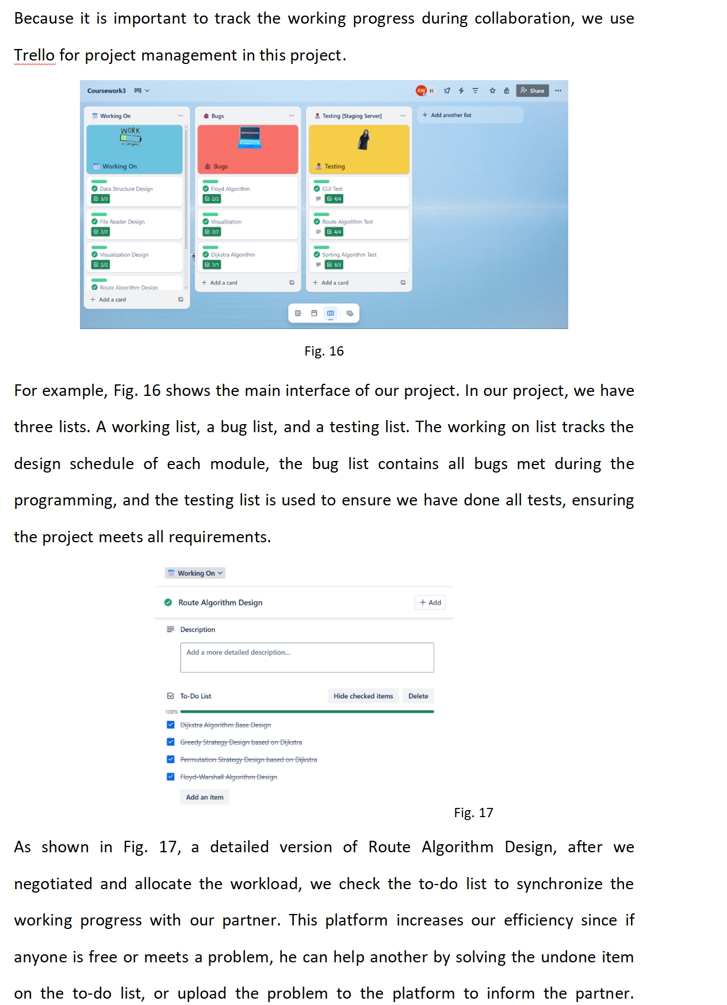
AI MAN tool Usage
For the usage of AI-assisted Software Management tool, a screenshot of the schedule/planning page is needed.
After the proof (screenshot), please also add the description (e.g., why you planned like so, how did you do the task allocation, how did you collaborate, ect).

Slide 7
Note that none of the following examples is mandatory for the project

Slide 8
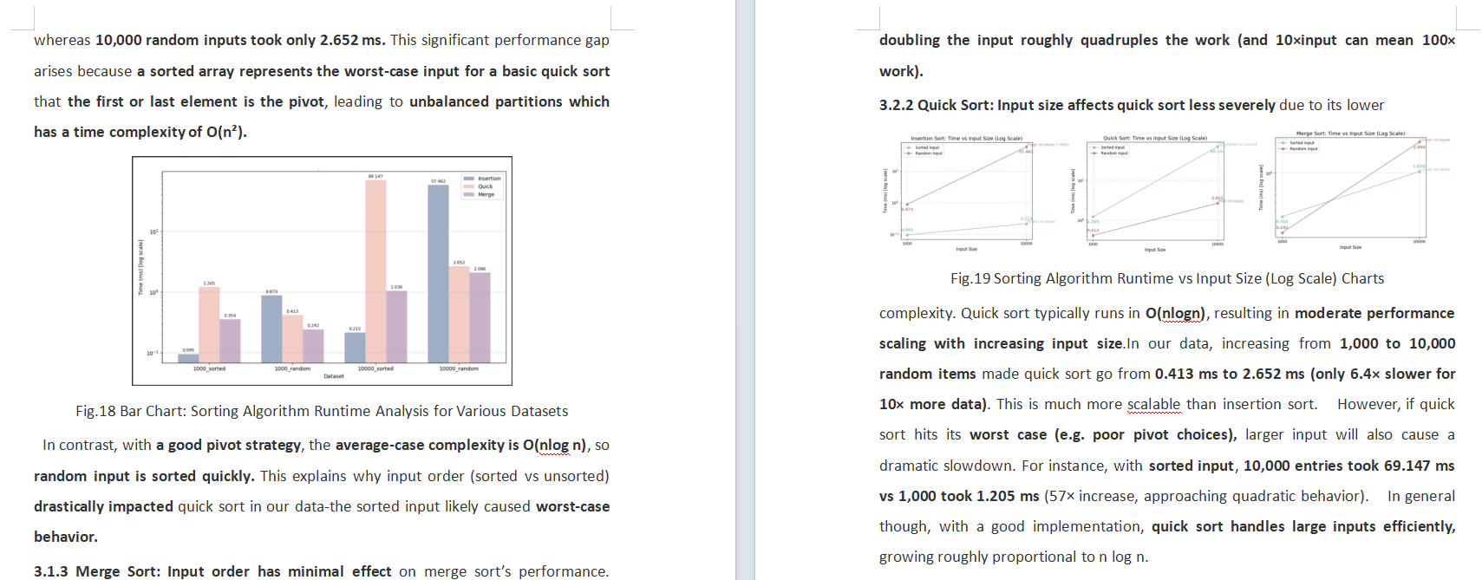
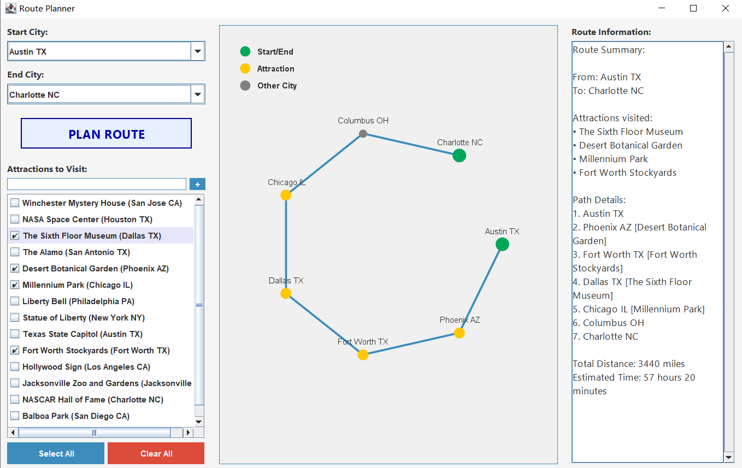
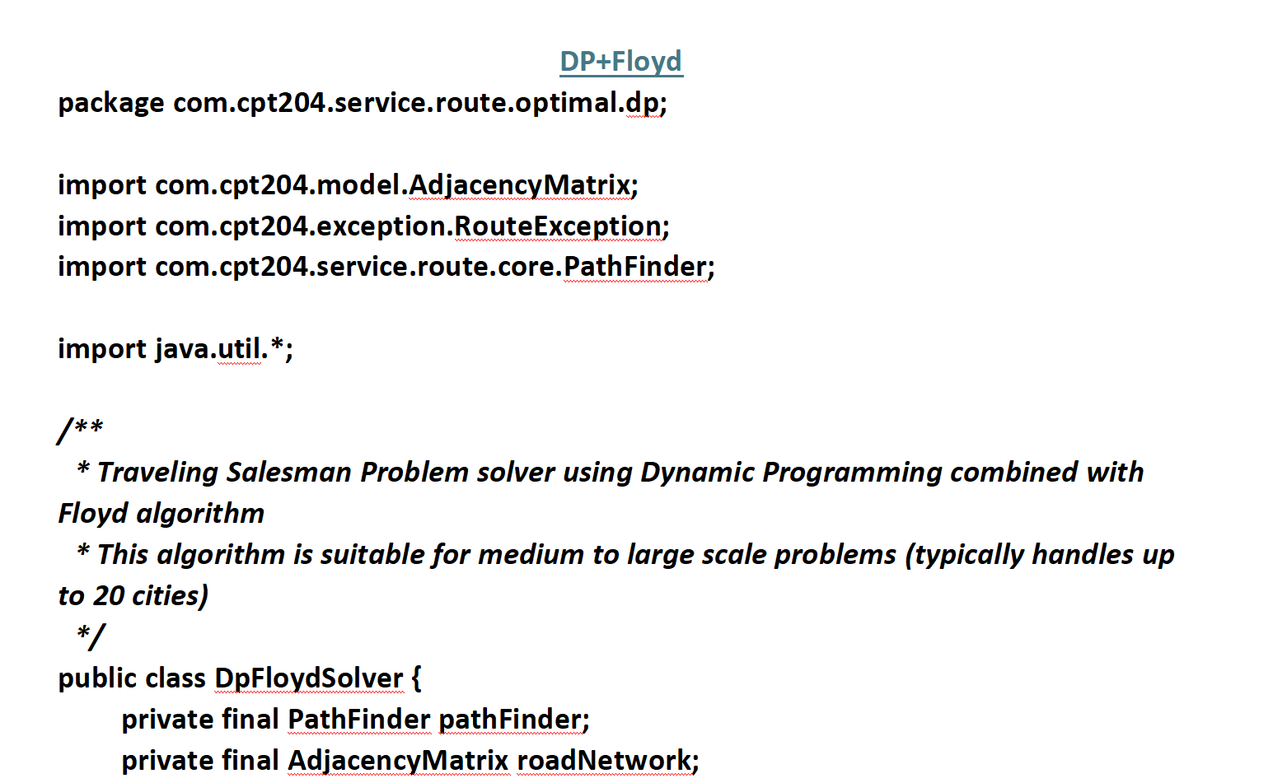
Icing on the cake
If you REALLY like to try some fancy moves:
Using statistical figures for questions requiring comparisions (e.g., the efficiency / cost of the algorithms in use)
Visualizing the graph outcome (JavaFX, Swing, AWT are allowed)
Actual implementation of the extra algorithms
More effort often leads to higher marks, but please manage your time wisely across different modules and assignments.

Slide 9
Reminders
4 files: a ZIP containing all of the code, a Word report, a MP4 video (max time 8 mins, max size 250M now), a PPT
Deadline: 24th May, 23:59
Do have a cover page
Page limit: 20 pages (only for Chaper 1-4). More contents go to Appendix.
Copy and paste the code in Chapter 5, NO screenshots
Please contribute equally. The max mark one can get is the mark the submission should have.
Both of the team members should appear in the video, presenting roughly equal amount of time (~4 minutes)
Reusing the provided codes (e.g., the sorting/grahp algorithm codes) is allowed, but think critically.
Only one teammate need to submit the work (the 4 files).
Feel free to come to office hour with any question. In-person talk (with your report/codes) is more efficient.

